Slide 1

Use of the Bayes Factor to Improve the Detection of Binary Black Hole Systems
Avi Vajpeyi
Rory Smith, Jonah Kanner
LIGO SURF 16
Notes:
My proj aims at trying to find more GW signals due to BBH sys in strain data, with the help of a new detection statistic known as the Bayes Factor

Slide 2
Summary
Introduction
Detection Statistic
Bayesian Statistics
Selecting Background Events
Bayes Factor
Results
Drawbacks
Bayes Coherence Ratio
Results
Comparison with SNR

Slide 3
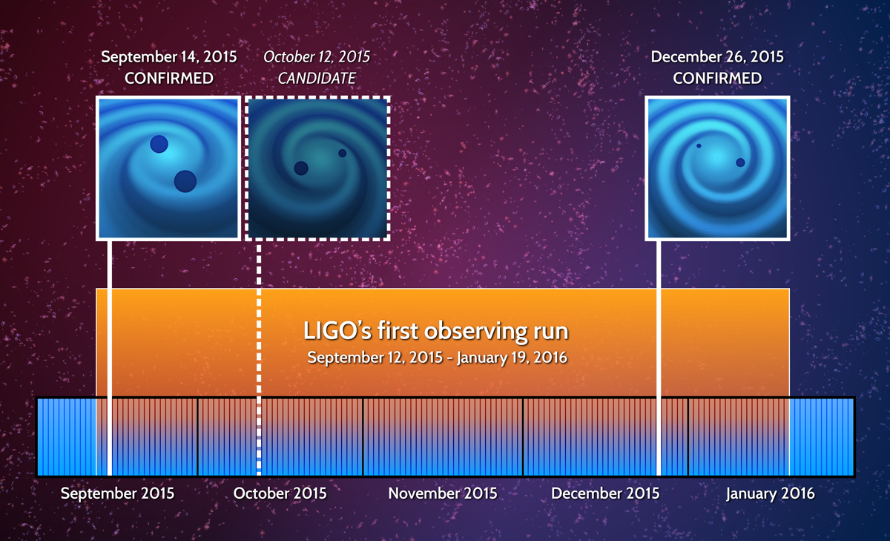
Overview
Some candidate events like LVT151012 have low Signal-to-Noise ratios which fall within the background distribution
Notes:
The main reason as to why we want to test a new detection statistic is because there are some candidate events which cannot be considered as real gravitational waves as they have SNRs close to that of the background

Slide 4
Overview
Can the Bayes factor help increase the detection confidence for binary black hole systems?
Notes:
We think that the bayes factor may be able to help Improve the detection confidence for events such as these
Now, id like to explain what a detection statistic is

Slide 5
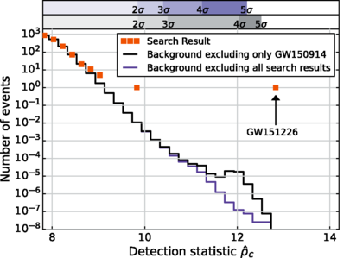
Detection Statistic
Search results from the two binary coalescence searches using a combined matched filtering signal-to-noise ratio
Notes:
A detection statistic is something quantifies the ability to discern between GW signals, and random patterns that distract from the signals, known as noise.
So on this plot, we have SNR as the detection statistic on the X Axis, and the number of events that occur per second on the Y axis.

Slide 6
Detection Statistic
The Background
Search results from the two binary coalescence searches using a combined matched filtering signal-to-noise ratio
Notes:
With the detection statistic, we can create a background distribution, which is what SNR values we get for data that contains no GW signal, and contains only noise
The foreground consists of SNRs values we get from data that could contain GW signals.
By comparing Foreground to background we can ask which foreground events are lounder than background

Slide 7
Detection Statistic
Some events stand out from background
Search results from the two binary coalescence searches using a combined matched filtering signal-to-noise ratio
Notes:
Some of these candidate events stand out from the background distribution

Slide 8
Detection Statistic
Some events fall along the background
Some events stand out from background
Search results from the two binary coalescence searches using a combined matched filtering signal-to-noise ratio
Notes:
At the same time, we can see several other candidate events that fall along the background distribution.
Hence we think we need a better way to look the data from these searches –
and we decided to investigate if the Bayes Factor can push such events further away from the background distribution

Slide 9
A Gentle Introduction - Bayesian Statistics
Notes:
Now, id like to give a breif introduction on Bayesian Stats, as initially, it confused the heck out of me

Slide 10
Bayesian Statistics
Probability of a hypothesis, H conditional some data D
‘Posterior Density’
Probability of Data given Hypothesis
‘Likelihood’
Probability of the Hypothesis
‘Prior’
P(D | H) P(H)
P(H | D) =
P(D)
Probability of the data
‘Evidence’
Notes:
Bayesian statistics helps us calculate Conditional probabilities for hypothesises, given some data.
So here we have the probability of some hypothesis given data D.
This is dependent on three things - the Likelihood, Prior, and evidence
Now lets consider an example of how Bayesian statistics works

Slide 11

Bayesian Statistics
Oh, man
Notes:
Imagine that one morn, you don’t feel right and you go online to figure out whats wrong .

Slide 12

Bayesian Statistics
Oh, man
HYPOTHESITIS
Notes:
Youre browsing the web, and you find an illness that catches yoiur eyes - HYPOTHESITIS

Slide 13
Bayesian Statistics
HYPOTHESITIS
P(H) =
you have hypothesitis
Notes:
As you read through the list of symptoms for this illness, you realize that you have all of them.

Slide 14
Bayesian Statistics
Oh, man
HYPOTHESITIS
P(H) =
you have hypothesitis
Probability of symptoms given the Hypothesis
P(S|H) =
= 0.95
Notes:
So lets say that there is a 95% chance of you getting those symptoms given that you have the illness,
You begin freaking out,
But then you recall Bayes Theorem which states that you need two other things to calculate the prob that you have the illness

Slide 15
Bayesian Statistics
P( You Can Get Hypothesitis)
P(S | H) P(H)
P(H | S) =
P(S)
P (You Can Get the Symptoms)
Notes:
You need the
The prior prb or the P[you could come down with Hypothesitis]
and the evidence or the P [you could get those particular symptoms ]

Slide 16
Bayesian Statistics
Oh, man
HYPOTHESITIS
P(H) =
you have hypothesitis
= 0.00001
Probability of symptoms given the Hypothesis
P(S|H) =
= 0.95
Notes:
You do a little more googling, and you discover that only 1/10000 people get this illness

Slide 17
Bayesian Statistics
Oh, man
HYPOTHESITIS
P(H) =
you have hypothesitis
= 0.00001
Probability of symptoms given the Hypothesis
P(S|H) =
= 0.95
The Evidence, or probability of having symptoms
P(S) =
= 0.01
Notes:
Now we we need the evidence – the probability of getting the symptoms.
Say the symptoms are something like a runny nose and a headache, something very common. Prob for having them is about 0.01

Slide 18
Bayesian Statistics
Ehh, I initially forgot about P(H)
Oh, man
(0.95) (0.00001)
P(H | S) =
(0.01)
P(H | E) =
0.00095
Notes:
With this, you can calculate the prob that you have the illness Given your symptoms , And you realsie that the probab is quite low

Slide 19
Bayesian Statistics
Oh, man
Bayes Theorem tells me how to calculate probabilities of hypothesis, or models
Notes:
So the theorem tells you the Prb that should be assigned to a hypothesis given some data
IN this case it tells you that
the chances that (you have the disease given your symptoms), are low

Slide 20
Bayesian Statistics
Oh, man
Bayes Theorem tells me how to calculate probabilities of hypothesis, or models
Helps compare different models!
Notes:
And as this theorem helps us calculate the Prob for hypothesises It can help us compare different hypothesese or models!

Slide 21
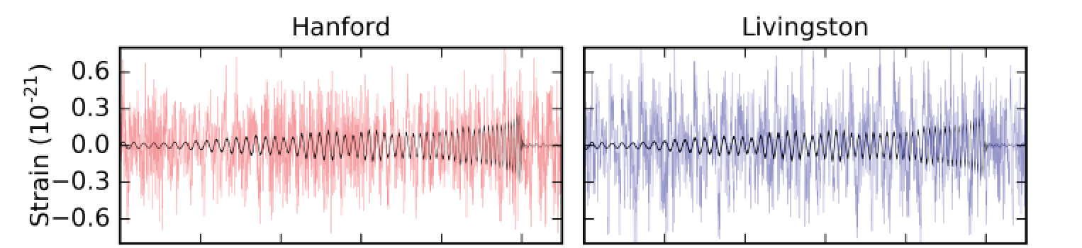
Models in GW
Hypothesis 1 : data = Gaussian Noise + GW Strain
Hypothesis 2 : data = Gaussian Noise
Notes:
The models we want to compare for GW signal analysis are
the model → D = Gaussian noise + a coherent GW signal (as in a signal present in both detectors) dependent on parameters such as masses, spins etc
And the model → D = Gaussian noise
in general the noise is not always Gaussian like when we have glitches and signals, but ill get into that later on

Slide 22
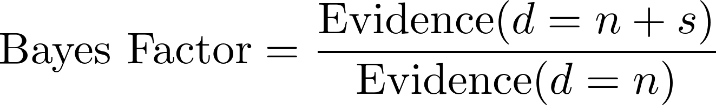
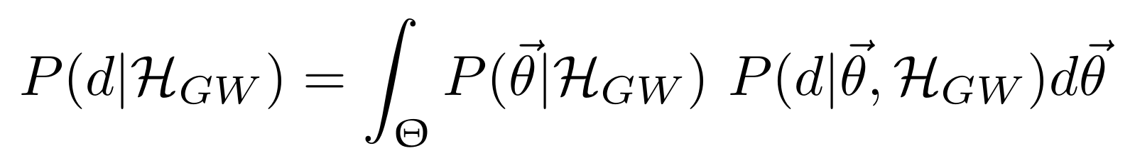
Bayesian Statistics
Parameter estimation is what we normally do
And using parameter estimation for multiple sets of data we get model selection
Notes:
The way we compare these models is by taking the ratio of their evidences

Slide 23
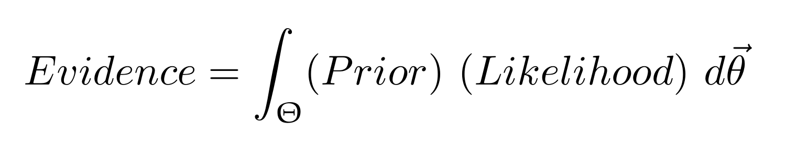
Bayesian Statistics
Product calculated for every set of parameters, Θ
( parameters like masses, spins etc of black holes )
Parameter estimation is what we normally do
And using parameter estimation for multiple sets of data we get model selection
Notes:
TO calculate the evidence for a model, We perform multiple parameter estimations and calculate the priors and the likelihood, with all the different combinations of parameters, Theta.
Because of the fact that we calculate this product for all the different set of parameters, the Bayes factor is more useful than the SNR

Slide 24
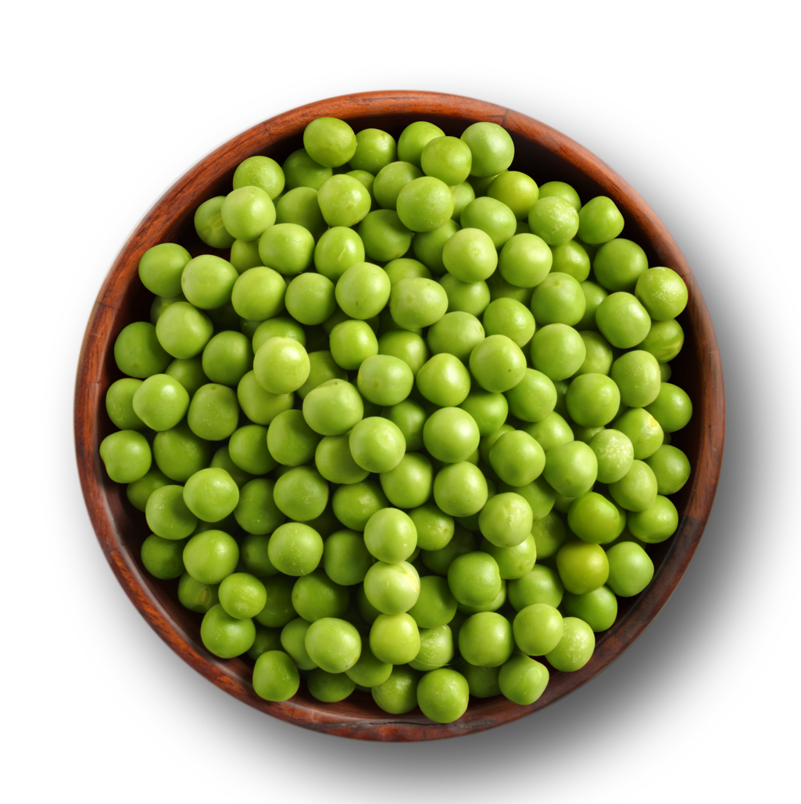

Bayes Factor vs SNR
Bayes Factor
Calculated using entire set of parameters (all possible templates)
Takes into account spins orientations, and magnitudes
Notes:
The Bayes Factor is calculated using the entire set of parameters , and also takes into consideration parameters such as the spins and spin orientations.

Slide 25
Bayes Factor vs SNR
Bayes Factor
Calculated using entire set of parameters (all possible templates)
Takes into account spins orientations, and magnitudes
All Parameters Considered
Notes:
So if all these peas represented different templates, each with some different combination of parameters, the Bayes factor is calculated considering this entire bowl of peas

Slide 26

Bayes Factor vs SNR
Signal to Noise Ratio
Maximum Likelihood Estimator (uses one template)
Does not consider spins orientations, and magnitudes
Notes:
On the other hand, SNR is a maximisation over all possible templates.

Slide 27
Bayes Factor vs SNR
Signal to Noise Ratio
Maximum Likelihood Estimator (uses one template)
Does not consider spins orientations, and magnitudes
One set of Parameters Considered
Notes:
The SNR uses only one template

Slide 28
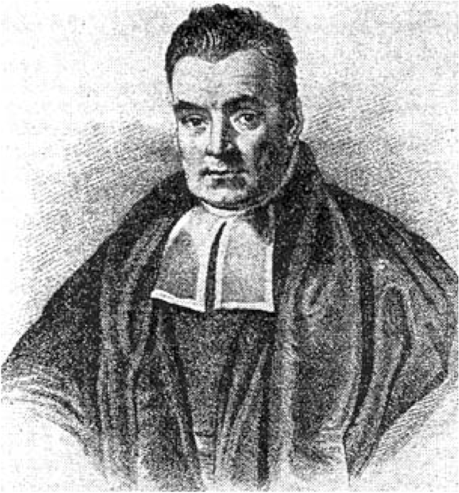
Project Motivations
Bayes Factor may prove to be more robust than the SNR
Notes:
HENCE, the bayes factor may be more robust than the SNR

Slide 29



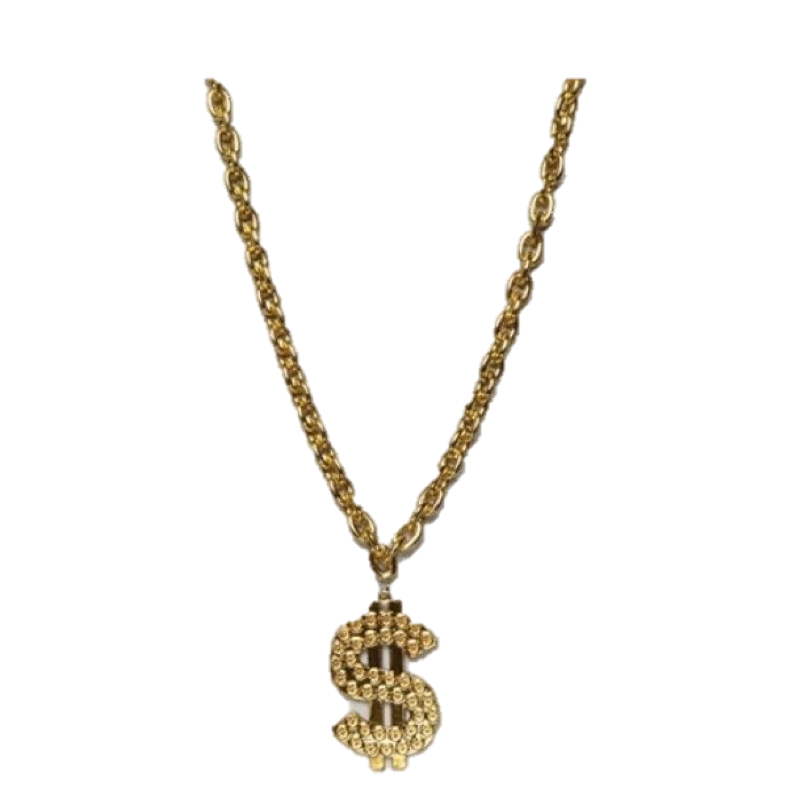

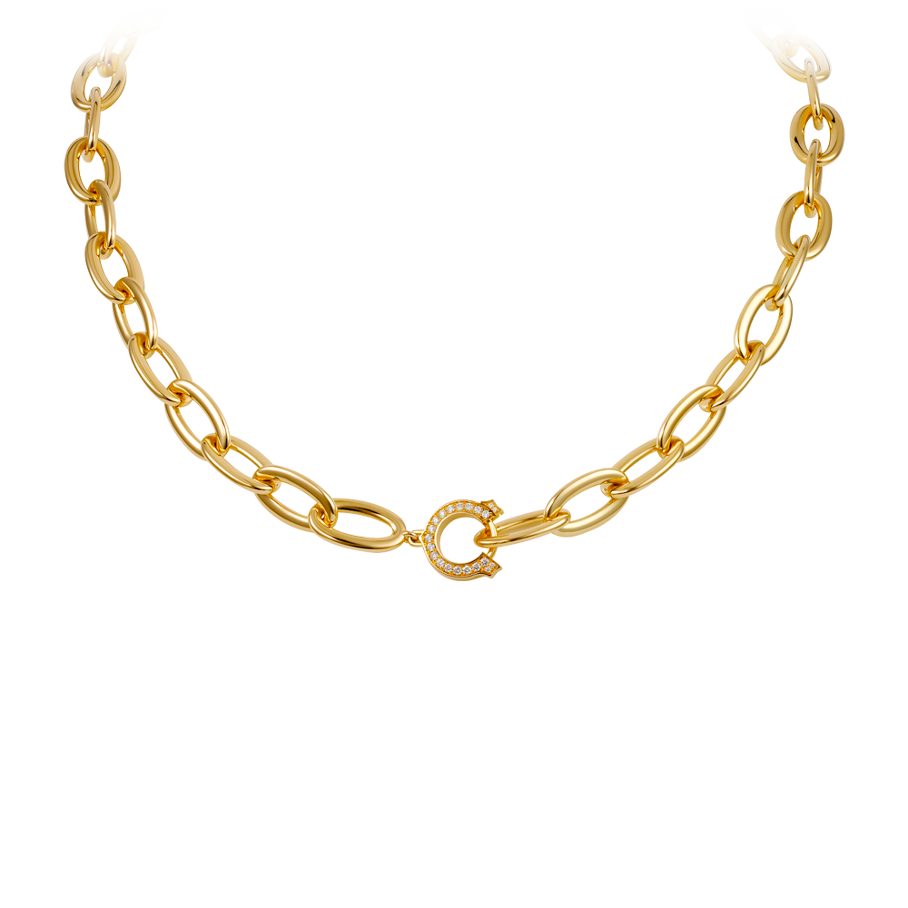
Project Motivations
Bayes Factor may prove to be more robust than the SNR
Bayes it bruh

Slide 30
Project Goals
Can we use the Bayes factor as a detection statistic?
Bayes it bruh
Notes:
And the main question that this project looks at is if we can use Bayes Factor as a detection statistic.

Slide 31
Obtaining the Bayes Factor
Once we run Parameter Estimations for the events, we can calculate the Bayes Factor
Ln Bayes Factors - GW signals:
GW150914 – 289.8 ± 0.3
GW151226 – 60.2 ± 0.2
LVT151012 – 23.0 ± 0.1
Values in ~10’s range
Ln Bayes Factors - Noise:
Values in ~1’s range
Notes:
So to use it as a detection statistic, we need to calculate BF for noise and for real signals and compare them
With LALinferneceNEST, we did some initial tests and calculated some BF for noise and signal events.
We learned that we get
log BF values ~ 10 for GW signals
and ~ 1s for noise events.
This tells us that it is e to the 10 times more likely GW signals to match the first model, that says d = n+s
this difference may be large enough for us to conclude with the BF if the candidate event is a signal or not.
To be certain, we need to compare these BF for signals to a large set of BF for noise events

Slide 32
Generating Background Data
Hanford Strain Data
Coherent Data
Livingston Strain Data
TIME
Notes:
And Since we CANT SHEILD LIGO FROM GW SIGNALS, we need to generate our own noise data

Slide 33
Generating Background Data
Hanford Strain Data
Incoherent Time Shifted Data
Livingston Strain Data
Time Shift > light travel time
TIME
Notes:
We do this by time shifting the data. Since we’re certain no GW signals exist in time shifted data, we call it background data
There have already been numerous time shifts that have been applied to data, resulting in several million years of background data
From this data, noise events above and SNR of 5 were recorded, and we took some of these background events and calculated the Bayes Factor for them.

Slide 34
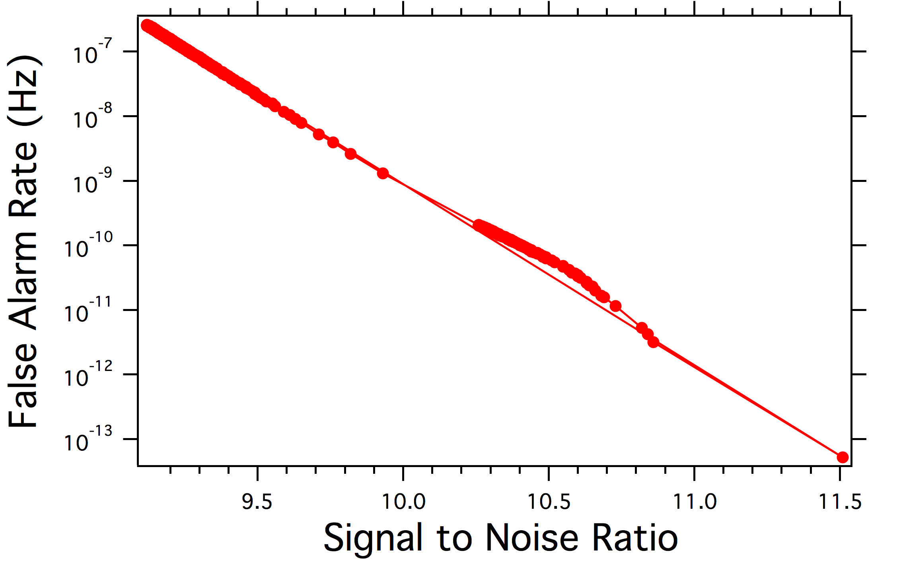
Generating Background Data
Lower the FAR, louder and rarer the event
False Alarm Rate Plotted Against The SNR
Notes:
As the background data was searched for SNR values above 5, each new value collected was counted. Using the count for each background event, a false alarm rate was be calculated. This is basically the number of times per second an event of a corresponding SNR is encountered. As we see on this plot, as we look at higher SNR events, we see that the FAR is lower, which tells us that these events are rarer.
We heavily down sampled the background events, and then using LALinferenceNEST we calculated the BF for those events.

Slide 35
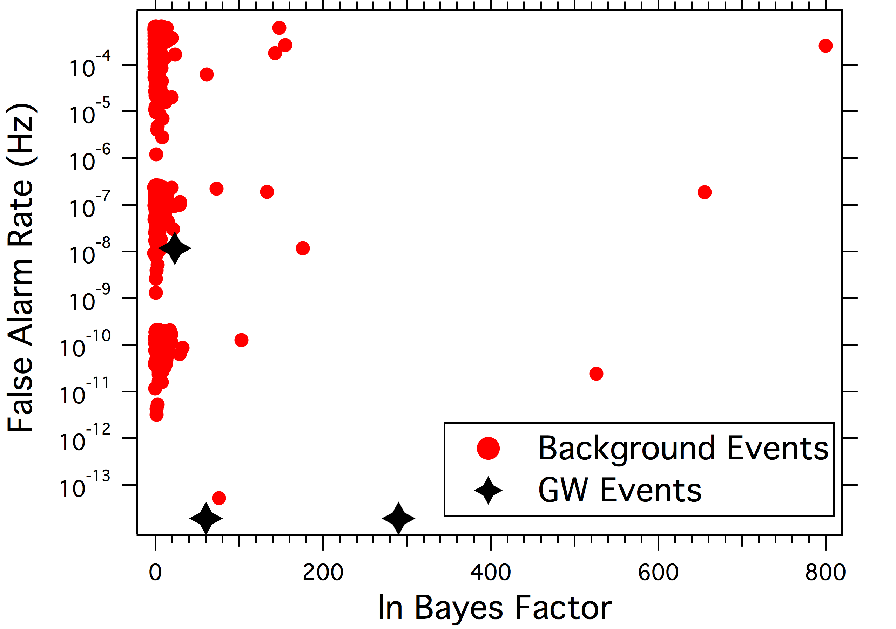
Bayes Factor Results
Bayes Factor as a Detection Statistic, using only Coalescing Binary Back Hole Templates
Notes:
Here is a plot of the BF as a detection statistic, with the False Alarm rate on the Y axis, where the FAR is the number of events that occur per second
We see that most of the background events fall in one category on the left side.

Slide 36
Bayes Factor Results
Bayes Factor as a Detection Statistic, using only Coalescing Binary Back Hole Templates
Notes:
However, we also see that some of the background events have HIGH BAYES FACTORS FOR NOISE EVENTS! Oh noooo!

Slide 37

Bayes Factor Results
Y U DO DIS
BAYES FACTOR?
Bayes Factor as a Detection Statistic, using only Coalescing Binary Back Hole Templates
Notes:
So we began thinking what could have cause this, and we realised that one reason might be due to non gaussian nose and glitches.

Slide 38
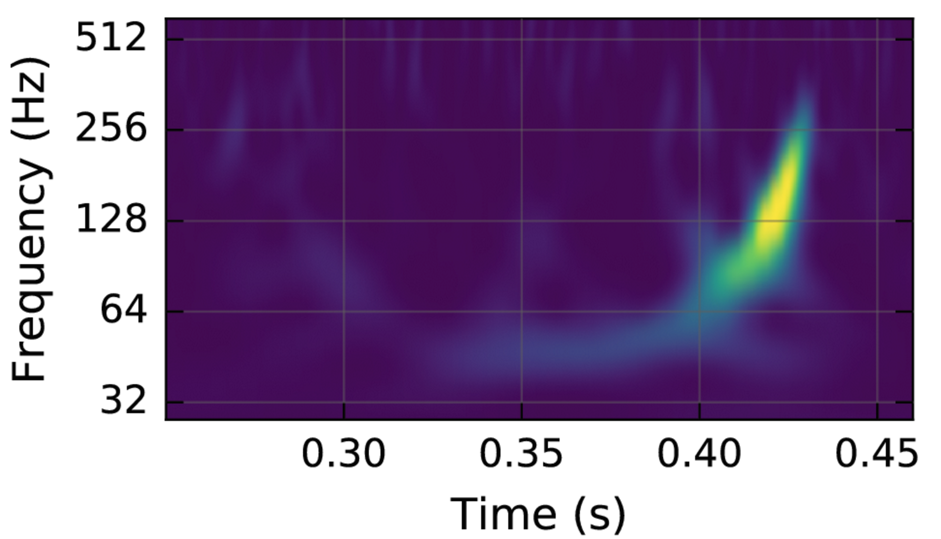
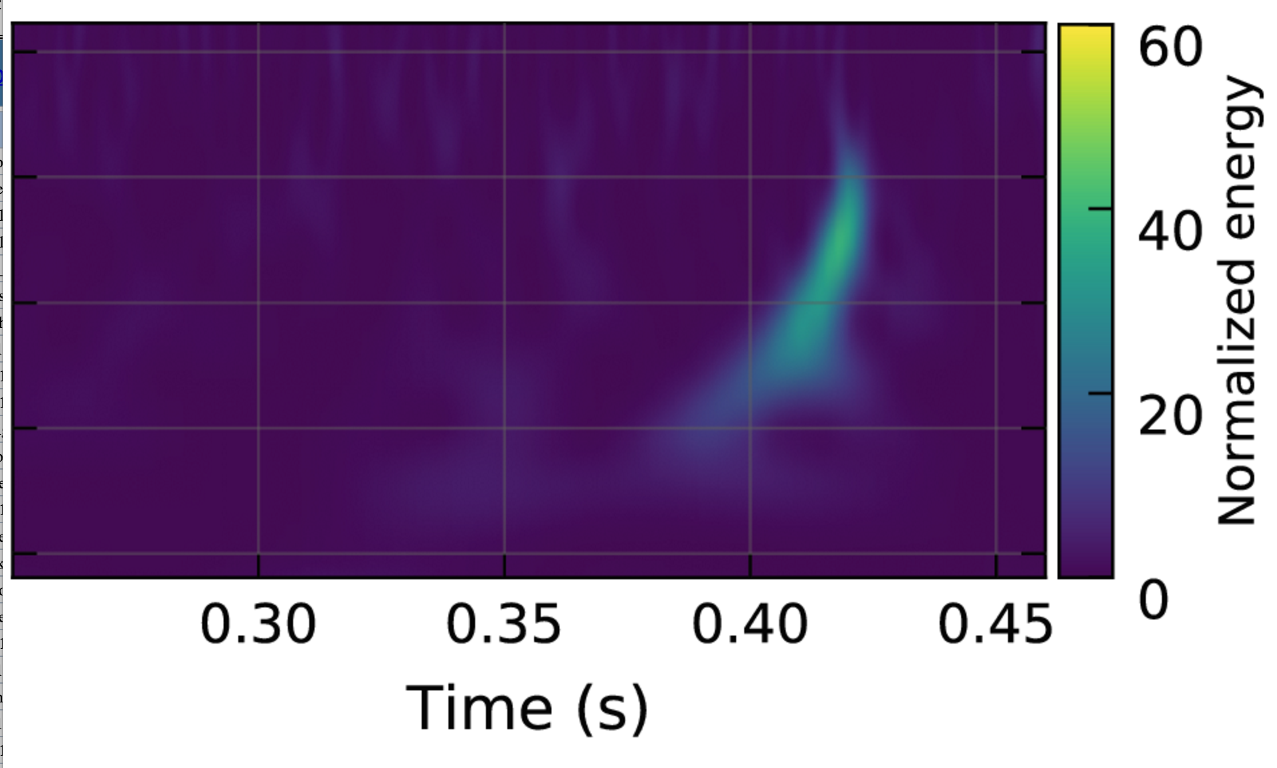
Issue with Bayes Factor
Real GW Spectogram
Notes:
SO this is what a spectrogram for a real gravitational wave signal looks like

Slide 39
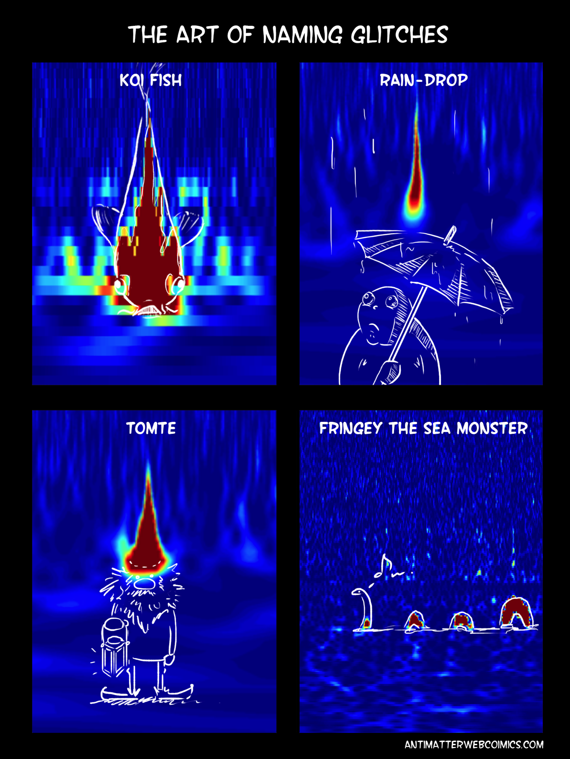
Issue with Bayes Factor
Real GW Spectogram
Glitch Spectograms
Notes:
The Problem is that sometimes we get glitches in our data. Glitches are non Gaussian features that are noise – but look like chirping signals ,

Slide 40
Issue with Bayes Factor
Hypothesis 1 : data = Gaussian Noise + GW Strain
Hypothesis 2 : data = Gaussian Noise
Notes:
This is problematic since our models expect GAUSSIAN NOISE. If we get non Gaussian noise, then our bf calculations gets thrown off.

Slide 41
Issue with Bayes Factor
A glitch in one detector’s data inflates the Coherent Bayes Factor
Livingston’s Strain Data*
Hanford’s Strain Data*
strain
strain
time
time
Coherent Bayes Factor = 142.82
* Figures are not real, Numbers are
Notes:
Say if there is a glitch in one detector, but no glitch in the other, it is hard to describe the data using coherent GW model , as no coherent features will be present in both data sets.

Slide 42
Issue with Bayes Factor
A glitch in one detector’s data inflates the Coherent Bayes Factor
Livingston’s Strain Data*
Hanford’s Strain Data*
strain
strain
time
time
Incoherent Bayes factor = 0.91
Incoherent Bayes factor = 152.58
Coherent Bayes Factor = 142.82
* Figures are not real, Numbers are
Notes:
If we analyse each data sets with incoherent GW models, we see that the BF for both the data sets are drastically different. hence we can conclude that the large coherent bayes factor is dominated by the large incoherent Bayes factor due to the Hanford’s Data set.
A potential fix to this problem is by using what we call a COHERENCE TEST
It tries to figure out if a glitch is present only in one detector.

Slide 43
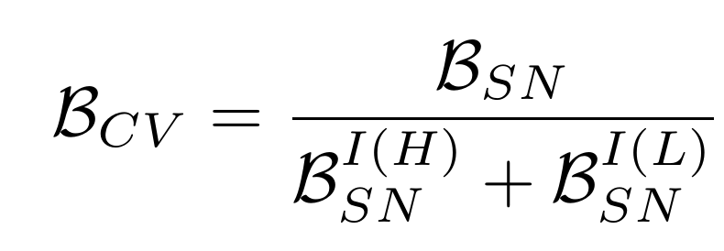
Bayes Coherence Ratio
R
The Bayes Coherence Ratio Reduces the error that appears in the Coherent Bayes Factor
Empirically we found this usefull
We can
Show plots with the Bayes Factor to help explain with the Bay
Compute numberator – not sensiive at all.
Introduce idea of incoherent analysis
Explain how the Bayes CR
Notes:
The Coherence test calculates the BCR, which
takes the coherent bayes factor, divides it by the
sum of the incoherent Bayes factors of data from both the independent detectors,

Slide 44
Bayes Coherence Ratio
COHERENT BAYES FACTOR
142.82
=
SUM OF BOTH DETECTOR’S
BAYES FACTORS
R
(0.91) + (152.58)
=
0. 93
Empirically we found this usefull
We can
Show plots with the Bayes Factor to help explain with the Bay
Compute numberator – not sensiive at all.
Introduce idea of incoherent analysis
Explain how the Bayes CR
Notes:
HENCE, if the coherent Bayes Factor is high, and this is due to the incoherent Bayes factor at only one detector, the BCR will be low

Slide 45
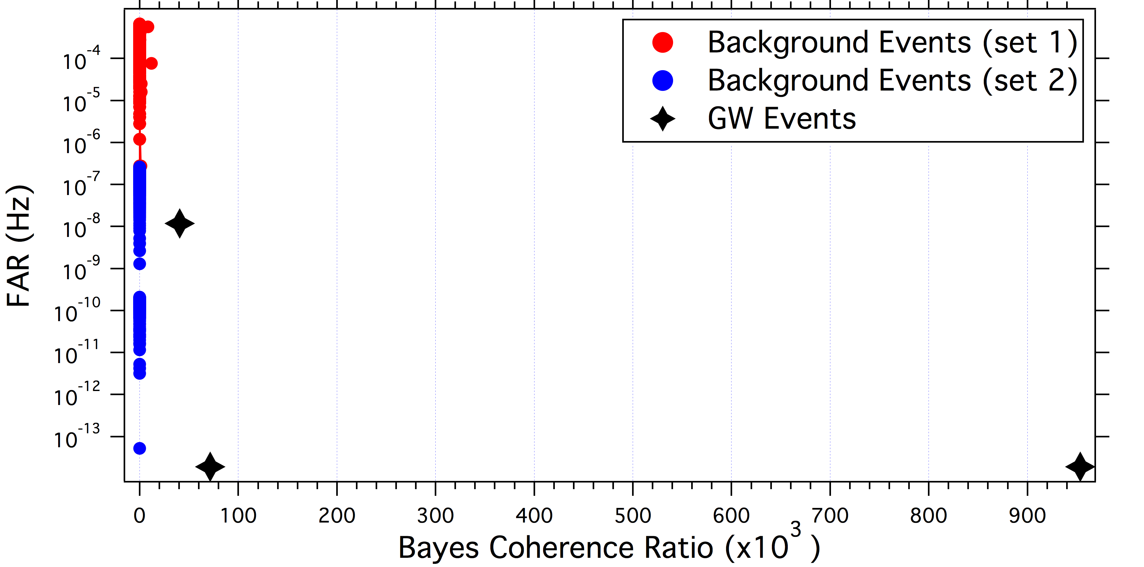

Results for Bayes Coherent Ratio
(6.7 x 10¹¹ , 10⁻¹⁰ )
OUTLIER
Bayes Coherence Ratio as a Detection Statistic
Notes:
Here we have a plot of the Bayes Coherence Ration as the detection stat on the X, and the false alar rate on the Y
Note that The chirp mass range for the red background events is in the 6 to 45 solar mass range, while the chirp mass for the blue background events are from the 24 to 45 solar mass range.
Now there are two interesting things, the background events seems to cluster really nicely into one group, and this highlights the GW signals. This is great, as the separation between the GW signals and the background is more than 40,000 . This is great!
however, there is one outlier which has an absurdly large BCR

Slide 46
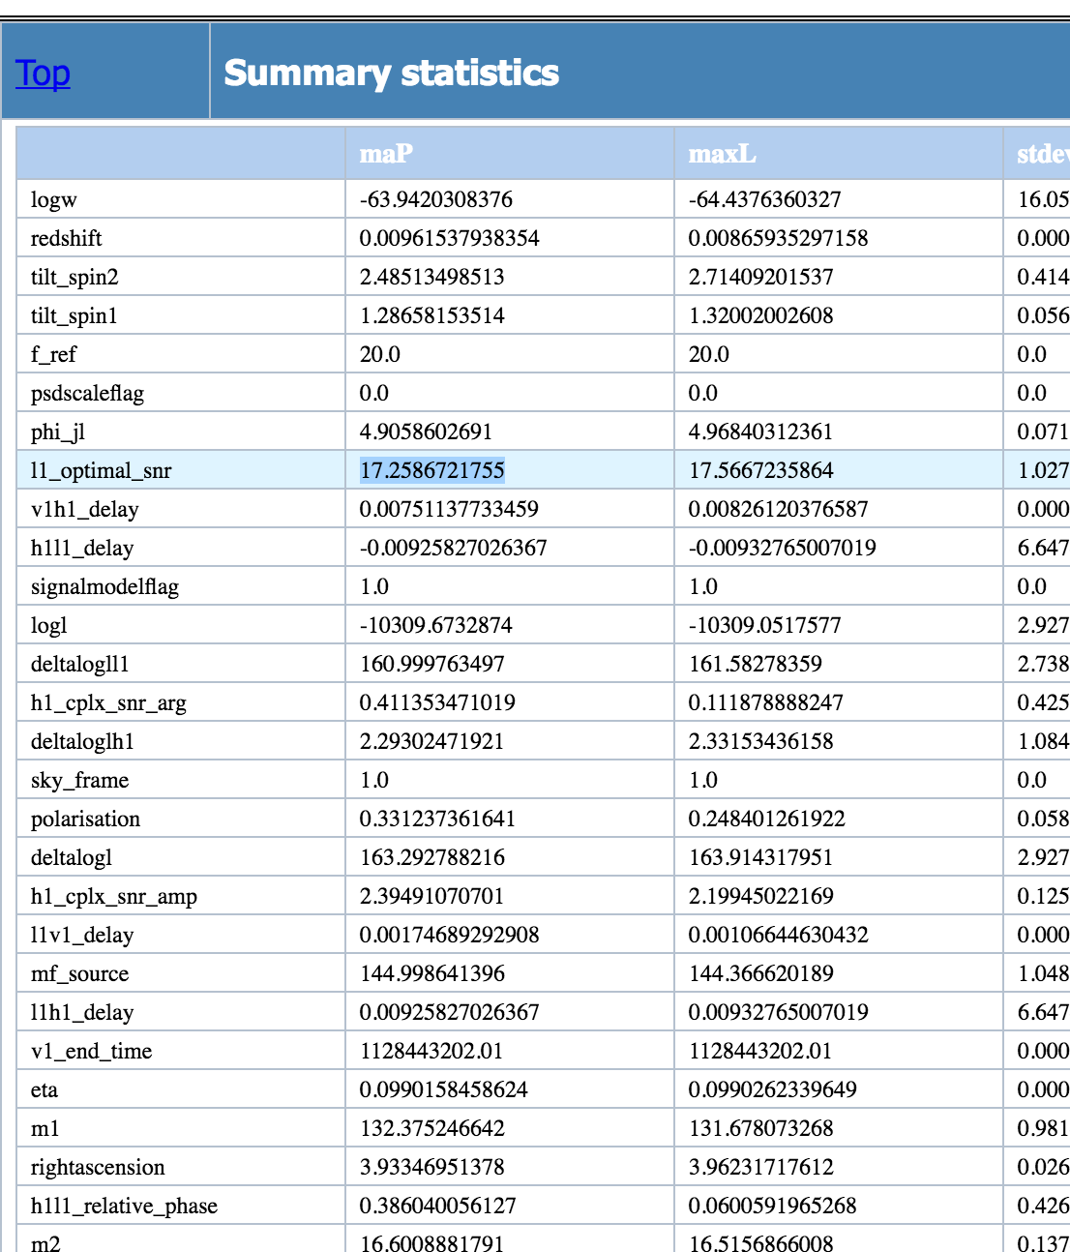
Additional Information Available
We have a lot of additional information that we could potentially use to distinguish the outlier as a glitch
L1 optimal SNR : 17.2
H1 optimal SNR : 2.6
Notes:
When we independently studied this background event, we found that its SNR from Livingstons data was 17.2, and its SNR at Hanford's data was 2.7, which tells us that this was not a coherent background event, and was most likely due to a glitch (coh SNR – 18)
Hence we concluded that only the BCR would not be enough to be used as a detection statistic – we would also need something like the SNR to help discriminate Signals from noise better, and get rid of potential outliers

Slide 47
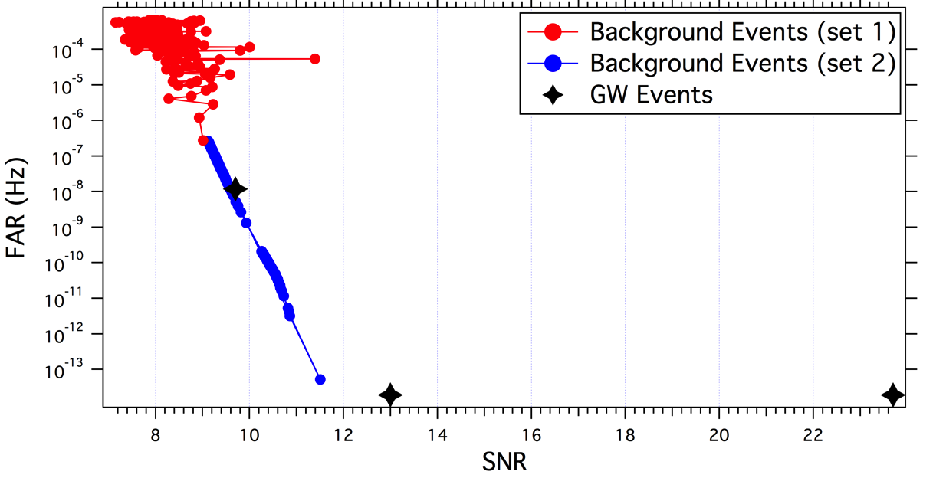

Comparing Detection Statistics
Signal-to-Noise Ratio as a Detection Statistic
Bayes Coherence Ratio as a Detection Statistic
Notes:
Here we can compare the SNR and the BCR as detection statistics.
If we look at the above graph, we see that a GW event falls along the background distribution, and hence we cant call it a GW event.
However, looking on the below graph,
We see that there is quite a large distance between the signal events from the background distribution
Hence we believe that the BCR may be a better detection statistic.

Slide 48
Conclusions and Future Work
Study the low FAR background events
Determine if BCR can be used in addition with SNR as a detection statistic
Expand the work for more mass bins
Repeat the Study with Binary Neutron Star Signals
Notes:
HOWEVER, much more work left
We need to figure out exactly what it is that can help the BCR to weed out outliers as we discussed earlier
We need to study the lower FAR events
We need to study the events for more mass bins
We need to repeat the experiment with Binary neutron star systems.
IN conclusion, we believe that the
BCR, with some additional information, is a promising way of distinguishing signals and noise events

Slide 49
Acknowledgements
Thanks to NSF, Dr Rory Smith, Dr Jonah Kanner, Professor Alan Weinstein and the LIGO SURF pen.
Notes:
I have learned sooo much and will really treasure this experience, it been amazing, and has really motivated me into getting into further studies in Physics

